Slide 1




This project has received funding from the European Union's Horizon 2020 research and innovation programme under grant agreement No 821282

Slide 2


TOOLS FAIR
This project has received funding from the European Union's Horizon 2020 research and innovation programme under grant agreement No 821282

Slide 3


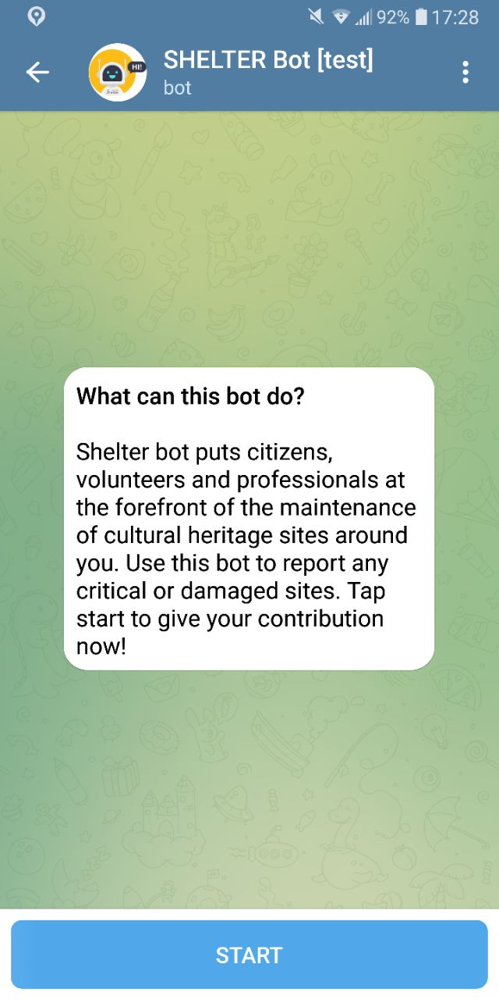


SHELTER Chatbot
Track people’s Location and Activity
Manage Missions
Send Reports
Receive Communications from the Control Room
Search «shltr_bot_test» in the Telegram search bar

Slide 4
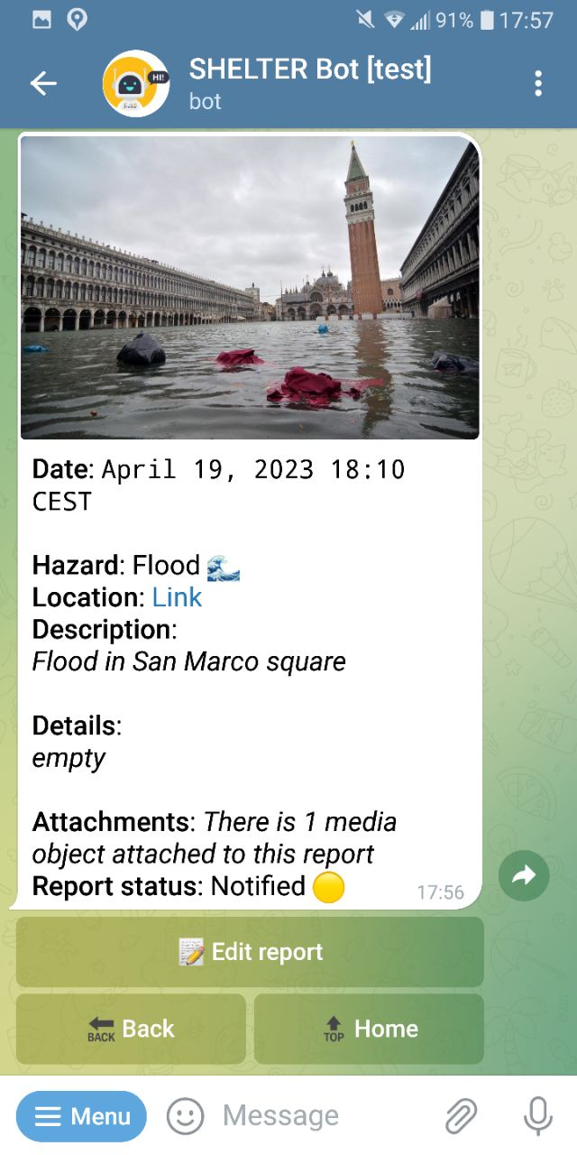
Activity plan
11:30 – 12:30
Login in the Chatbot with your own credentials
Update Location and Status
A message will arrive with a new Mission created
Send a Report with Location, Photo and Description and attach it to the Mission

Slide 5
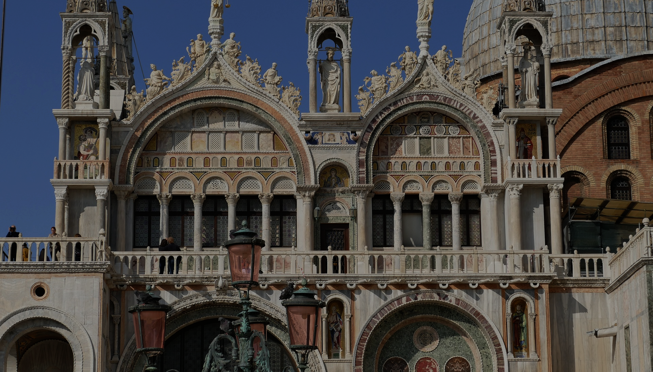
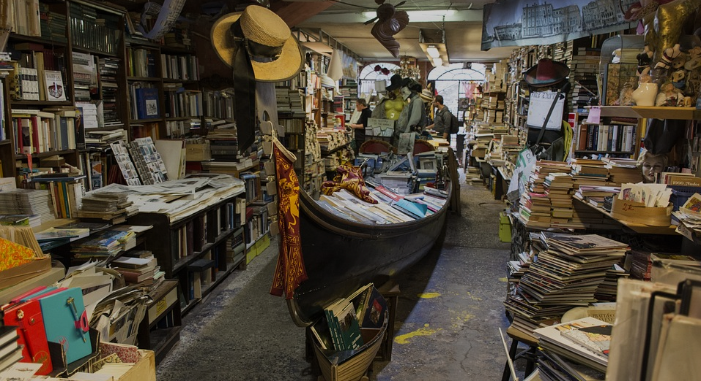

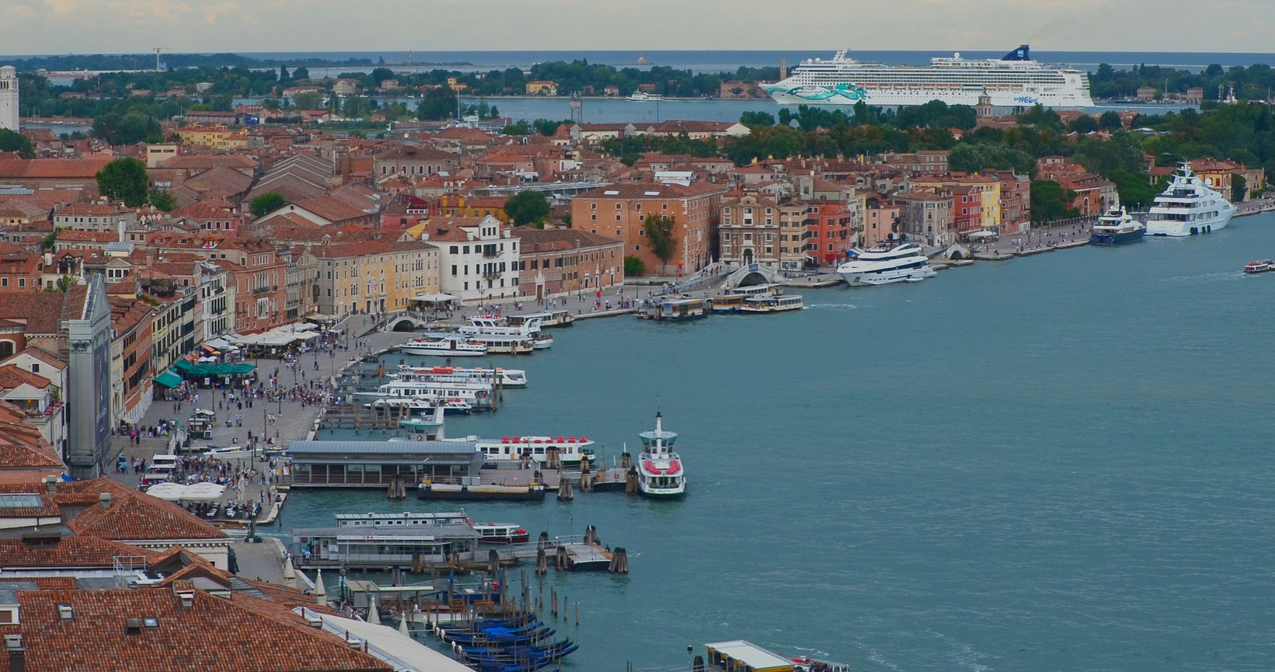
SAN MARCO
SQUARE
ACQUA ALTA BOOKSTORE
© Angelika - Pixabay
© Mirko Bozzato - Pixabay
FONDAZIONE QUERINI STAMPALIA
RIVA DEGLII SCHIAVONI
© Fondazione Querini Stampalia
© Sabine Kroschel- Pixabay

Slide 6
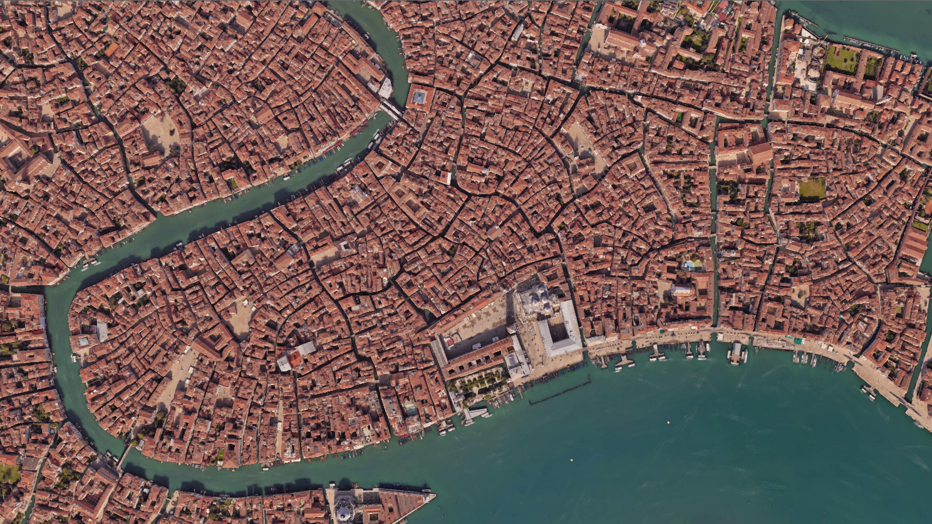

Libreria Acqua Alta
Fondazione Querini Stampalia
YOU ARE HERE
Basilica San Marco
Riva degli Schiavoni

Slide 7






















THANK YOU!

